Slide 1



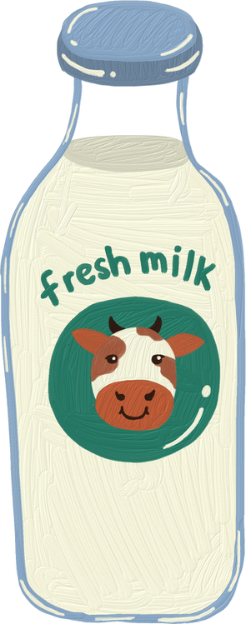

Quality Cost Analysis
SCM 517 - Case Study #1
Team 401
Divyansh Shrivastava
Lucas Smith
Kavya Murugan
Sami Fahim
Sravani Bolla

Slide 2



Welcome to Our Store

Slide 3

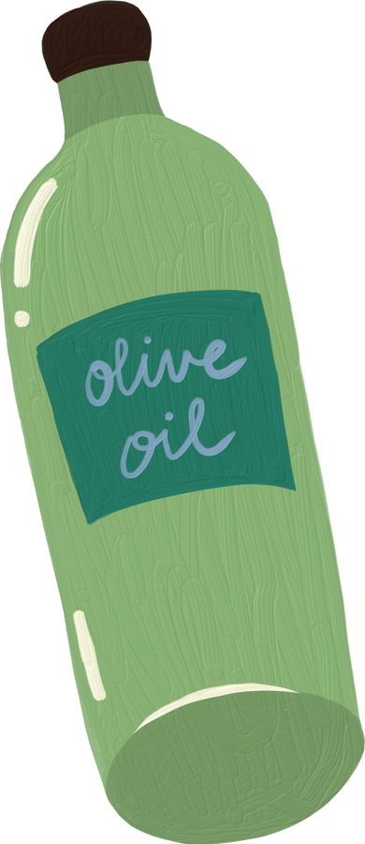


Introduction
Grocery stores play a vital role in the daily lives of consumers, serving as essential providers of food and household items. With an extensive range of perishable and non-perishable products, these establishments face unique challenges in maintaining quality and ensuring customer satisfaction. Effective quality management is critical for grocery stores, not only to meet customer expectations but also to optimize operational efficiency and reduce financial losses.

Slide 4



Quality Cost Analysis
Quality cost analysis is a valuable tool for grocery stores to identify and evaluate the costs associated with preventing, detecting, and addressing defects in their products and services. This analysis categorizes costs into four primary areas: internal failure costs, external failure costs, prevention costs, and appraisal costs. By examining these categories, grocery stores can gain insights into their quality management processes, pinpoint areas for improvement, and ultimately enhance their overall performance.

Slide 5





Internal Failure Quality Costs
Expired or Spoiled Inventory
If perishable goods go bad due to poor stock rotation or inadequate storage conditions, they must be discarded resulting in waste
Damaged Goods
Grocery items may be damaged during storage, handling, or transport within the store. This results in them having to be written off – and ultimately a financial loss
Rework Costs
If products are mislabeled or improperly packaged (incorrect pricing tags or barcodes), the store must spend time and resources correcting the issues before they are ready for sale
Notes:
AI Prompt: “Provide examples of internal failure quality costs for a grocery store”

Slide 6
External Failure Quality Costs
Customer Complaints
Customer complaints cause the store to incur costs associated with resolving said complaints including labor and customer service resources
Product Returns
The return of expired/defective/poor quality products results in a loss of revenue and also incurred costs related to restocking and/or disposal
Health and Safety Issues
If a customer becomes ill due to consuming expired or contaminated food, the store could face legal liabilities which could be costly to resolve
Notes:
AI Prompt: “Provide examples of external failure quality costs for a grocery store”

Slide 7
Prevention Quality Costs
Employee Training
Costs related to ongoing training for staff on proper food handling, storage, stocking, customer service, etc.
Inventory Management Systems
Investments in Inventory management software to track stock levels, expiration dates, and forecasting
Pest Control Programs
Regularly implementing pest control measures in the store and storage areas to prevent contamination or damage to food products by pests such as insects or rodents
Notes:
AI Prompt: “Provide examples of prevention quality costs for a grocery store”

Slide 8
Appraisal Quality Costs
Quality Inspections
Costs associated with inspecting shipments of products to ensure items meet quality and freshness standards
Customer Satisfaction Surveys
Costs associated with gathering customer feedback
Expiration Date Monitoring
Costs associated with the labor involved in checking products on shelf and marking down or removing items that are nearing their expiration dates
Notes:
AI Prompt: “Provide examples of appraisal quality costs for a grocery store”

Slide 9
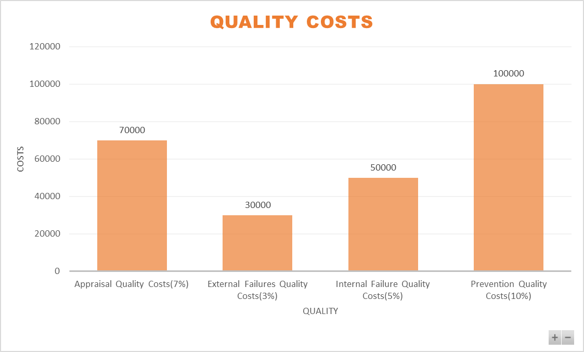
Quality Costs Representation
For the grocery store’s quality cost analysis, we assumed that it’s a well-established business with around 10 years of experience, reflecting a stable and mature operation.
With an assumed history of effective quality management, we allocated higher costs to Prevention Quality Costs of 10% ($100,000), reflecting proactive measures such as inventory management and staff training to prevent issues.
Appraisal Costs of 7%($70,000) are also substantial, representing regular quality checks.
Internal Failure Costs of 5% ($50,000) and External Failure Costs of 3%($30,000) are comparatively lower, as we assumed preventive investments help minimize spoilage and complaints.
Reference: Business Quality Cost Report

Slide 10
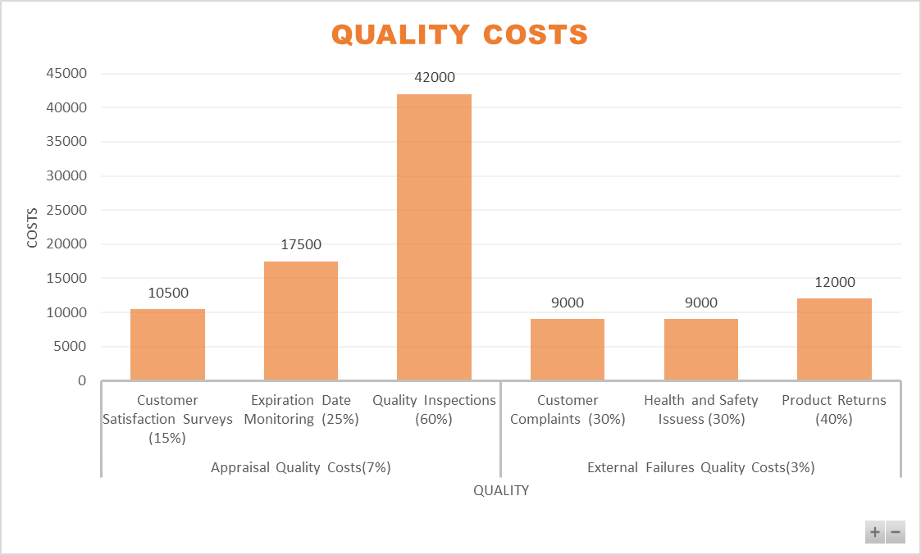
Quality Costs Representation: Appraisal Quality Costs & External Failures Quality Costs
For the grocery store’s quality cost analysis, we assumed that it’s a well-established business with around 10 years of experience, reflecting a stable and mature operation:
Appraisal Quality Costs ($70,000):
We assumed higher spending on Quality Inspections of 60% ($42,000) due to frequent checks on perishable goods.
Expiration Date Monitoring of 25% ($17,500) and Customer Satisfaction Surveys of 15% ($10,500) were also included to keep product quality and customer experience consistent.
External Failures Quality Costs ($30,000): Costs like Customer Complaints of 30% ($9,000) and Product Returns of 40% ($12,000) reflect occasional quality lapses. Health and Safety Issues of 30% ($9,000) cover risks related to product handling.
References: American Society for Quality (ASQ) - ASQ provides resources and case studies on quality management in various industries, including grocery. Their reports often contain examples of cost breakdowns.

Slide 11
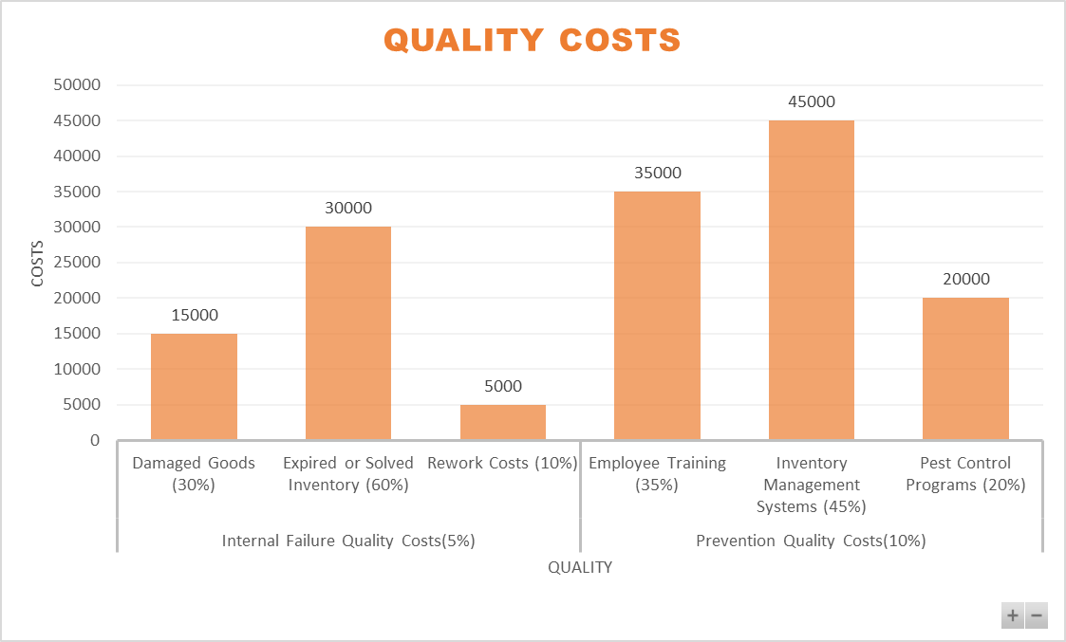
Quality Costs Representation: Internal Failure Quality Costs & Prevention Quality Costs
For the grocery store’s quality cost analysis, we assumed that it’s a well-established business with around 10 years of experience, reflecting a stable and mature operation:
Internal Failure Quality Costs ($50,000):
We assumed higher costs for Expired or Spoiled Inventory of 60% ($30,000) and Damaged Goods of 30% ($15,000) due to handling perishable items.
Rework Costs of 10% ($5,000) are minimal, as rework mainly involves minor packaging adjustments.
Prevention Quality Costs ($100,000):
Major expenses for Inventory Management Systems of 45% ($45,000) were assumed to ensure accurate stock levels and reduce waste.
Employee Training of 35% ($35,000) helps staff handle products properly, while Pest Control Programs of 20%($20,000) are necessary to maintain cleanliness.
References: American Society for Quality (ASQ) - ASQ provides resources and case studies on quality management in various industries, including grocery. Their reports often contain examples of cost breakdowns.

Slide 12

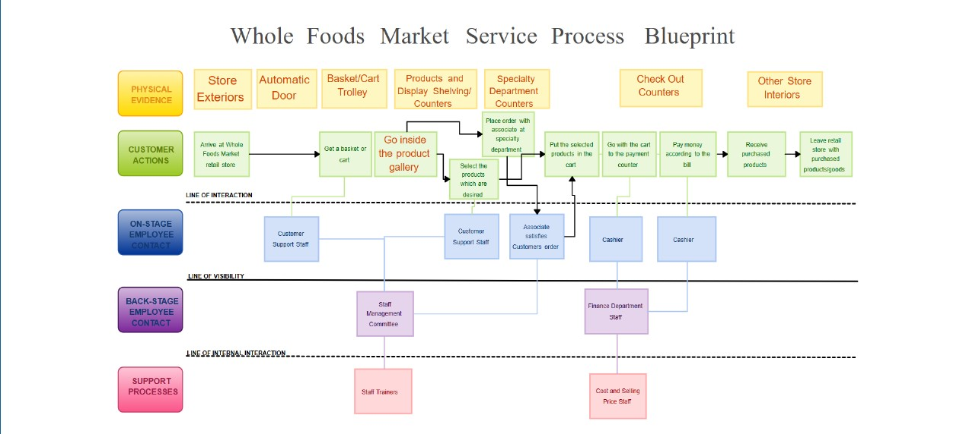
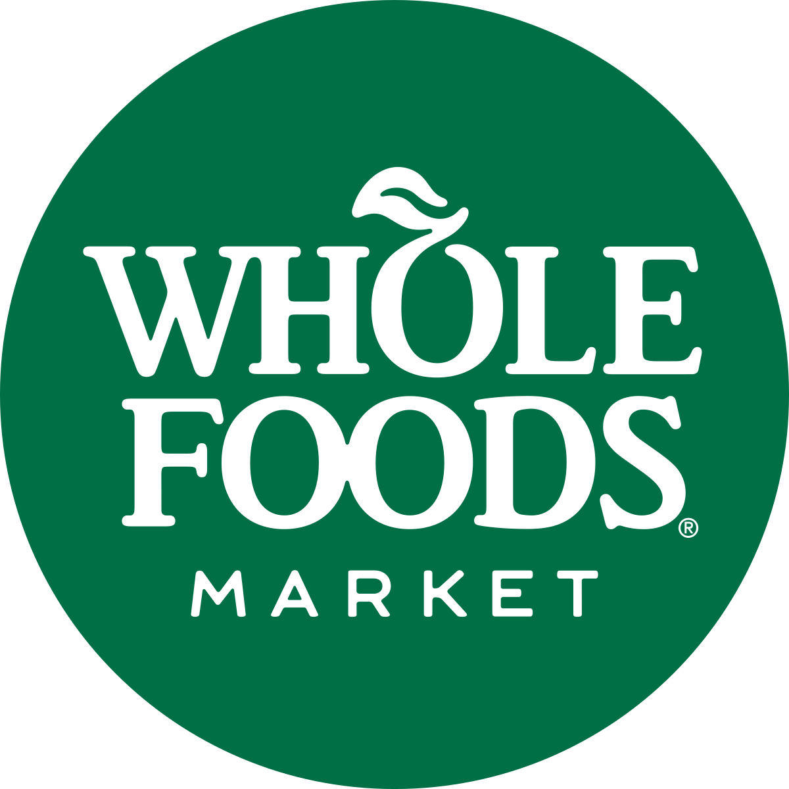
Process Maps for Grocery Stores
Source: Whole Foods Market - Service Process Blueprint
Notes:
https://creately.com/diagram/example/ila7z8fp1/whole-foods-market-service-blueprint-classic

Slide 13
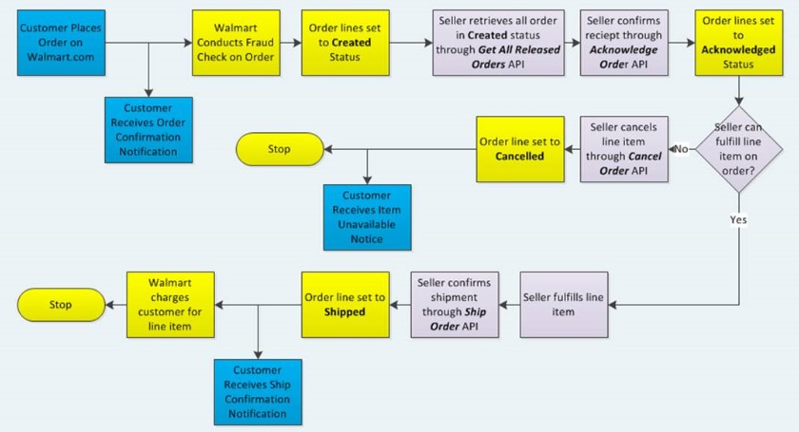

Process Maps for Grocery Stores
Source: Walmart - Order Management API
Notes:
https://creately.com/diagram/example/ila7z8fp1/whole-foods-market-service-blueprint-classic

Slide 14
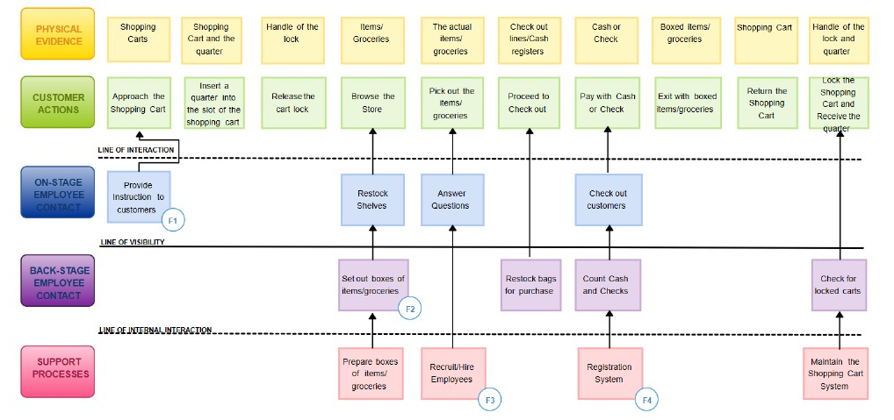

Process Maps for Grocery Stores
Source: ALDI - Service Blueprint
Notes:
https://creately.com/diagram/example/ila7z8fp1/whole-foods-market-service-blueprint-classic

Slide 15

Similarities Between Maps
Customer Journey Focus:
All three maps show end-to-end processes with a clear customer journey, from the start to the completion (e.g., shopping, checkout, order fulfillment).
Multiple Touchpoints Involving Employees/Systems:
Each process map involves stages where employees or systems (like cashiers, order systems, or sellers) interact with customers.
Front-line interaction: Retail staff (in Maps 1 & 2) and APIs confirming order details (Map 3).
Defined Process Flow with Decision Points:
Each map includes logical decision points (e.g., whether items are available, whether the cart is locked, or if the seller can fulfill the order).
Notes:
https://creately.com/diagram/example/ivn0bt0t/aldi-classic

Slide 16
Differences Between Maps
Particulars | Process Map 1 - Whole Foods | Process Map 2 - Online Order - Walmart | Process Map 3 - ALDI
Process Medium | Physical retail shopping | Fully online, automated process | Physical shopping with cart mechanism
Employee Visibility | Clear distinction between on-stage, backstage, and support staff | No front-stage employee contact; system APIs manage fulfillment | Similar but fewer distinctions
Customer Actions | Browsing products, selecting items, interacting with employees | Placing an order online, receiving notifications | Using carts, browsing, paying at checkout
Decision Points | Choice of products to buy | Seller decision to fulfill or cancel order | Locking/returning carts, payment methods
Automation Level | Low (manual customer interactions) | High (order APIs automate the process) | Low (manual with some cart systems)
End Process | Customer exits with products | Order shipped or canceled based on stock availability | Customer returns cart and exits store
Notes:
https://creately.com/diagram/example/ivn0bt0t/aldi-classic

Slide 17



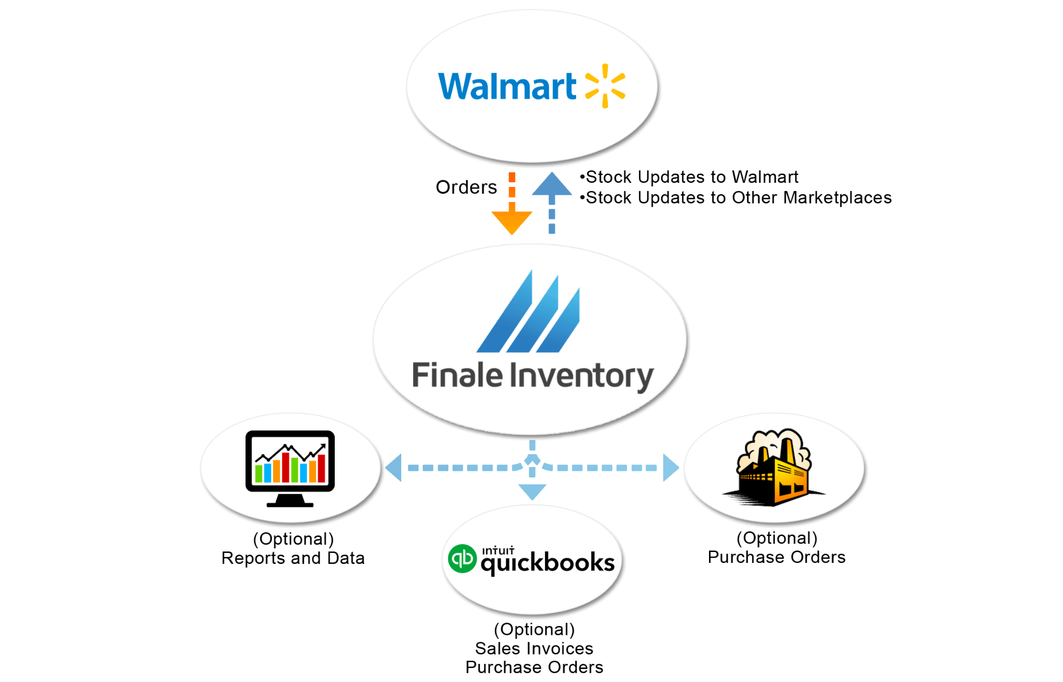









Business Analytics
Business Analytics Focus: Inventory Optimization
Walmart emphasizes the importance of advanced analytics in optimizing its inventory management. The company uses sophisticated data analytics to forecast demand accurately, ensuring that products are stocked in the right quantities at the right times.
Source: The #1 Open Source Inventory Management | Odoo

Slide 18
Business Analytics
Key Points:
Demand Forecasting: Walmart analyzes historical sales data and seasonal buying patterns to predict customer demand. This allows the company to reduce excess inventory and minimize waste, particularly for perishable goods.
Supply Chain Efficiency: By leveraging real-time data, Walmart can streamline its supply chain operations, ensuring timely restocking and reducing stockouts. This efficiency contributes to a smoother shopping experience for customers.
Customer Satisfaction: The effective management of inventory helps maintain product availability, directly impacting customer satisfaction and loyalty.
Example Insight: During peak seasons or promotional events, Walmart's analytics enables the company to adjust inventory levels proactively. This adaptability not only supports their cost-reduction initiatives but also reinforces their commitment to sustainability by reducing waste.

Slide 19



Thank You!

